Slide 1
Beam-ACO Approach For Data Collection in Heterogeneous Wireless Sensor Networks
With the guidance of:- Dr. Prasenjit Chanak, Assistant Professor of the Department of CSE
BY: Rijul Singla Rakesh Banoth
22075070
22075018

Slide 2
INTRODUCTION:
The proliferation of wireless sensors and IoT devices in remote areas necessitates data collection using mobile sinks (MSs).
Despite challenges like limited energy, MSs—robots, MVs, or UAVs— navigate these regions, gathering sensor data and relaying it to base stations, which is crucial for various applications, including environmental monitoring and military operations.
Traditionally, in wireless sensor networks (WSNs), data collection schemes using mobile nodes rely on synchronized data generation, assuming all sensors produce data concurrently.
Heterogeneous WSNs (HWSNs), which comprise sensors with diverse computing capabilities, communication protocols, power supplies, and sensor types, pose additional challenges compared to conventional WSNs with homogeneous sensors.
The problem can be modelled as a Travelling Salesman Problem with Time Windows (TSPTW). It is a significant tool in logistics for modeling routing and task scheduling. In routing scenarios, it addresses the challenge of efficiently visiting multiple customers within specified time windows, starting and ending at a central depot. Different time windows in TSPTW can model the heterogeneity of the network due to different sensors.

Slide 3
Literature Review
Authors | Approach | Limitations
Z. Lin, H.-C. Keh, R. Wu, and D. S. Roy | Dynamically choose data collection points in each phase to balance longevity and quality | Does not reward nodes with larger data.
Osamy, A. Salim, A. M. Khedr, and A. A. El-Sawy | Established energy-conscious disjoint supreme sets, serving as data-gathering nodes per phase to enhance the network’s lifespan | Maintains extra overhead of sleep-awake scheduling
N. Kumar, P. Rani, V. Kumar, S. V. Athawale, and D. Koundal | Formulated an improved energy-efficient clustering strategy aimed at boosting the network’s lifespan and curbing energy usage in HWSNs. | Clustering can cause problems with outliers.
M. Yang, N. Liu, Y. Feng, H. Gong, X. Wang and M. Liu | Employ a twin PPO and Deep Q-Learning model to estimate rewards and find the optimal path | Deep learning approach takes significant computation.
T. Palanisamy, D. Alghazzawi, S. Bhatia, A. A. Malibari, P. Dadheech, and S. Sengan | introduced a framework for scheduling multi-sensor data synchronization of HWSNs to enhance data gathering efficiency at the sink in HWSNs | Uses GAT and vector feautiruzation which involve significant overhead.

Slide 4
OBJECTIVE :
Collection of data in a heterogeneous wireless sensor network(HWSN). Optimal path planning that minimizes the energy consumption and also maximizes the data consumption.

Slide 5
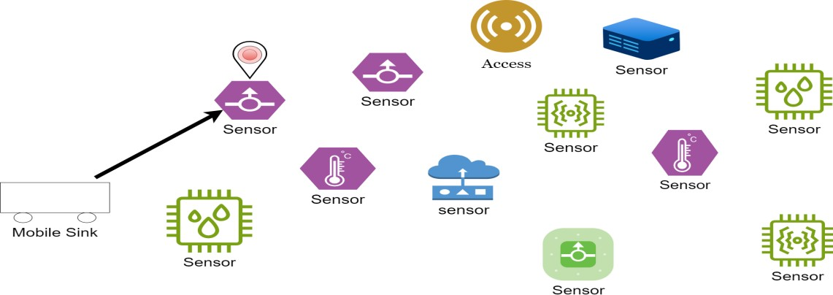
PROBLEM FORMULATION:-
1. SYSTEM MODEL: This system comprises wireless sensors, one MS depot, and one data station. The data station, serving as the endpoint for data collection, could be a nearby base station, Wi-Fi access points, satellite stations, or similar facilities.
a. ASSUMPTION OF SENSORS: In an area with sparsely distributed wireless sensors, each sensor can only connect with one MS at any given time. These sensors generate sensory data and initiate collection tasks with designated time windows. Each sensor (i ∈ I) determines the collection time window for its data as [e_{i}, l_{i}], where (e_{i}), indicates the time of data generation, and (l_{i}) is based on the maximum delay limit of the data (excluding the average transmission delay from the sensor to the data center).

Slide 6
ASSUMPTION OF MS:
MSs connected to base station links leading to backend servers receive sensor locations, data generation settings, control messages, and other updates.
We denote the MS's moving speed and energy consumption throughout the experiment as v m/s, q_{m} J/m, respectively. Each MS accesses only one sensor node at a time for data collection.
ASSUMPTION OF DEPOT:
Within the specified region, a solitary depot exists at location Ls, the initial point of the Mobile Sink's (MS) trajectory. This depot can replenish the MS's energy at any given time.
TSPTW:
In the context of an undirected complete graph G = (N, A), where N = {0, 1,…., n} represents nodes comprising the depot (node 0) and ‘n’ sensor nodes and A=N*N is the set of edges connecting these nodes, a solution to the Travelling Salesman Problem with Time Windows (TSPTW) entails a tour that encompasses visiting each node precisely once, commencing and concluding at the depot.
Thus, a tour can be denoted as P = (p₀= 0, p₁,……, p_{n}, p_{n+1} = 0), where the subsequence (p₁, p₂, ……, p_{n})constitutes a permutation of the nodes in N, and p_{k} represents the index of the customer at the kth position of the tour. Including p₀ = 0 and p_{n+1} = 0 ensures that each tour initiates and terminates at the depot.

Slide 7
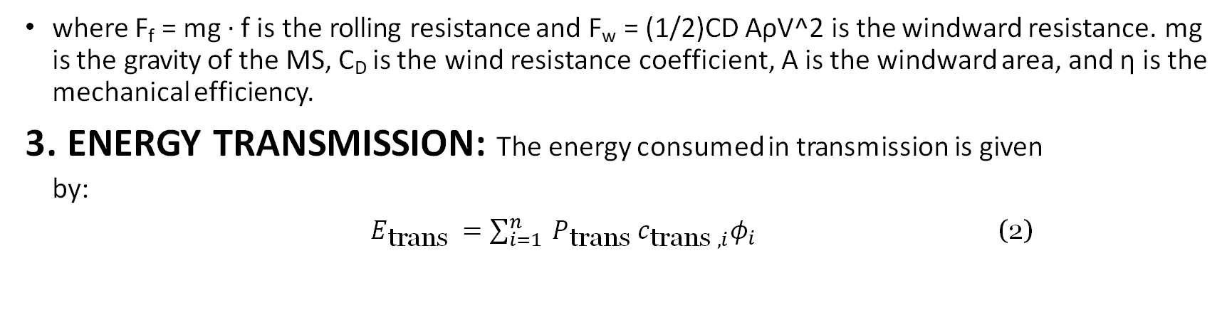
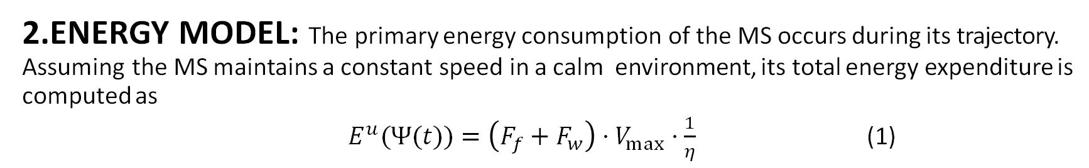
2.ENERGY MODEL: The primary energy consumption of the MS occurs during its trajectory. Assuming the MS maintains a constant speed in a calm environment, its total energy expenditure is computed as
${ E}^{u}(Ψ(t))=\left(F_{f}+F_{w}\right)⋅V_{max}⋅\frac{1}{η}$ (1)
where F_{f} = mg · f is the rolling resistance and F_{w} = (1/2)CD AρV^2 is the windward resistance. mg is the gravity of the MS, C_{D} is the wind resistance coefficient, A is the windward area, and η is the mechanical efficiency.
3. ENERGY TRANSMISSION: The energy consumed in transmission is given
by:
$E_{\text{trans} }=\sum_{i=1}^{n}{ }P_{\text{trans} }c_{\text{trans} ,i}φ_{i }$ (2)

Slide 8
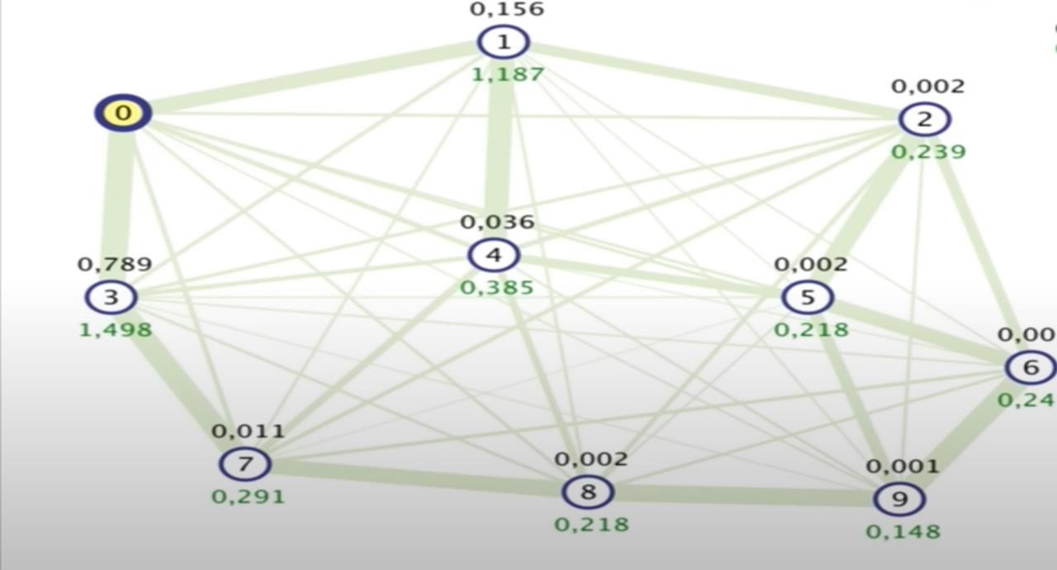
PROPOSED SOLUTION:
We utilize a hybrid approach, combining Ant Colony Optimization with Beam search, to address the data collection challenge in heterogeneous wireless sensor networks (HWSNs).
Ant colony optimization (ACO) is a problem-solving
methodology that constructs solutions probabilistically.
In each iteration of the algorithm, multiple solutions
are independently built. In contrast, Beam-ACO
employs a probabilistic beam search technique.
This method generates multiple parallel and
interdependent solutions in each iteration. During
each construction step, beam search maintains
A specific number of the best partial solutions for
further extensions are needed.

Slide 9

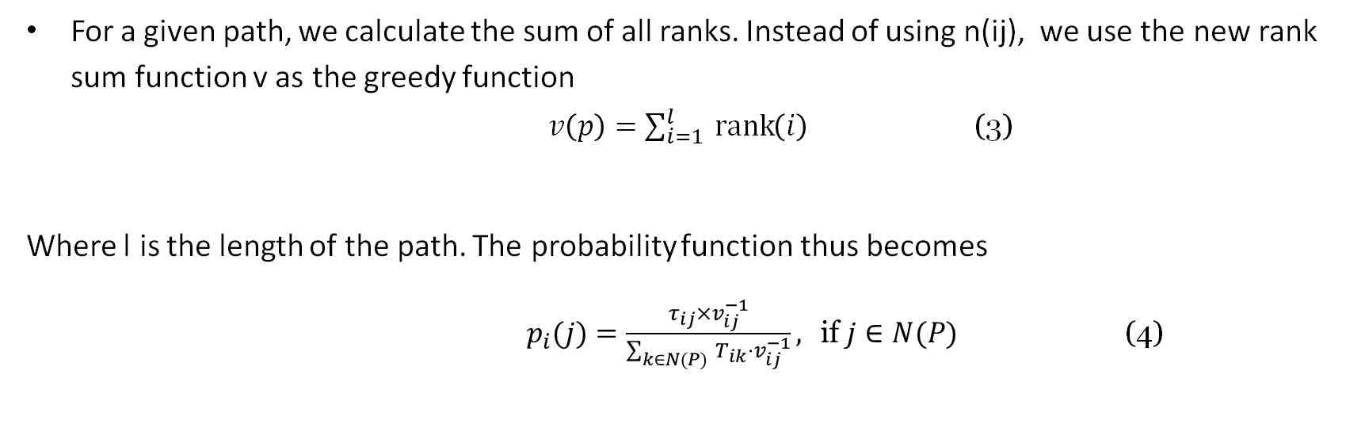
For a given path, we calculate the sum of all ranks. Instead of using n(ij), we use the new rank sum function v as the greedy function
$v\left(p\right)=\sum_{i=1}^{l}{ }\operatorname{rank}\left(i\right)$ (3)
Where l is the length of the path. The probability function thus becomes
$p_{i}(j)=\frac{τ_{ij}×v_{ij}^{−1}}{\sum_{k∈N(P)}{ } T_{ik}⋅v_{ij}^{−1}}, \text{if} j∈N(P)$ (4)
The ranks are calculated by and compared on the product of t(ij) and n(ij) as
$n_{ij}=λc⋅\frac{c_{max}−c_{i}}{c_{max}−c_{min}}+λl⋅\frac{l_{max}−l_{j}}{l_{max}−l_{min}}+λe⋅\frac{l_{max}−l_{i}}{l_{max}−l_{min}}+λp⋅\frac{φ_{max}−φ_{i}}{φ_{max}−φ_{min}}$ (5)

Slide 10
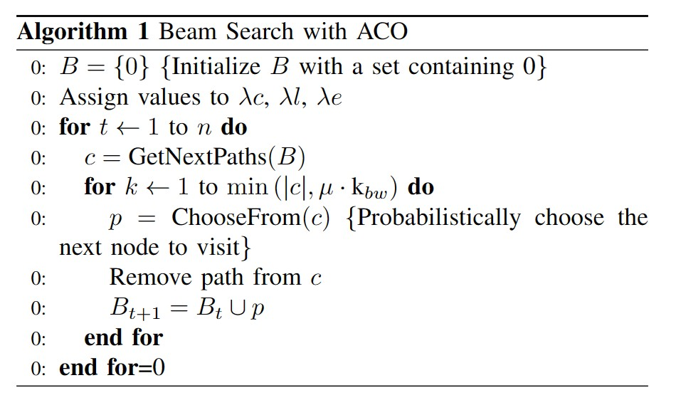
In one iteration of algorithm 1, we obtain a single path. We run through
this algorithm multiple times with the primary goal of reducing the number
of violations.
(Mobile Sink arriving at the node outside its time window) and
the secondary goal of reducing path length. The ChooseFrom function takes in a list of paths and outputs a single path with probabilities given by 3.

Slide 11
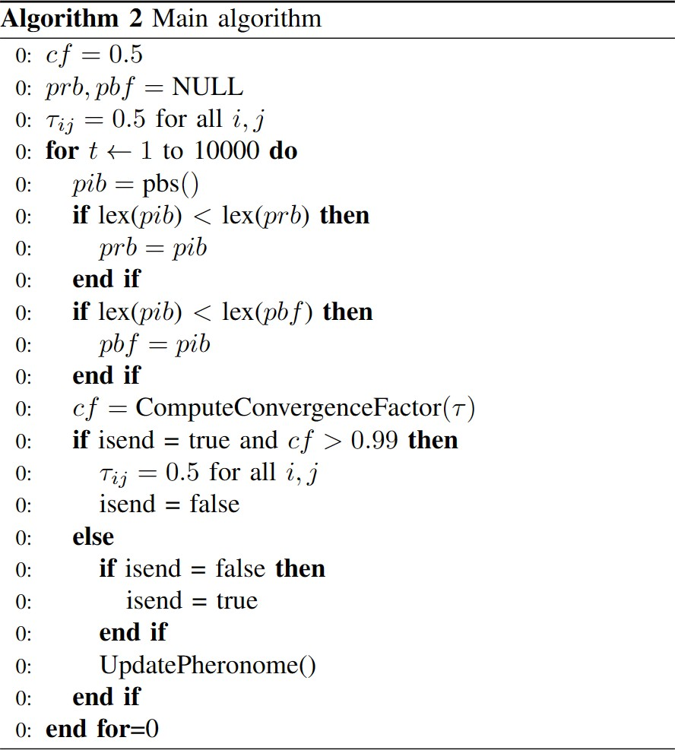

$cf=2\left(\frac{\sum_{τ_{ij}∈ℐ}{ } max\left\{τ^{max}−τ_{ij}τ_{ij}−τ^{min}\right\}}{|𝒯|⋅\left(τ^{max}−τ^{min}\right)}−0.5\right)$ (6)
To compare 2 paths, we use a lex function. If the number of violations of the first path is more than 1 less than the number of the second, we deem the first one to be a lexicographically smaller path. In case of conflict, we use the travel cost as the tie-breaker.
The following gives the convergence factor calculation after every iteration.

Slide 12
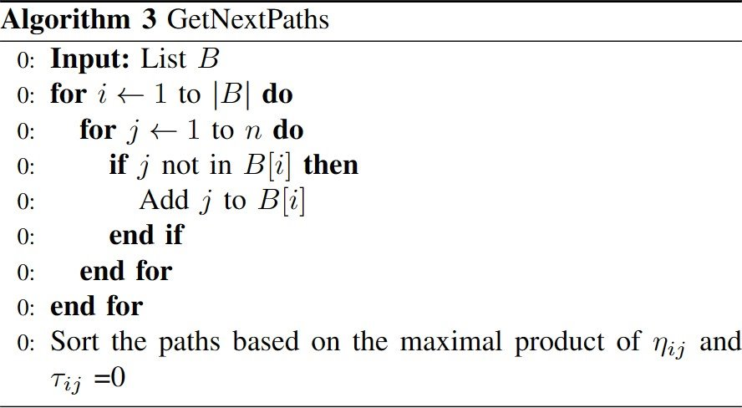
The GetNextPaths function takes in a list of paths as an input. It exhaustively adds the next unvisited node to all the paths, making the algorithm exhaustive and complete. It then returns a sorted list where the probabilities sort all the paths.

Slide 13
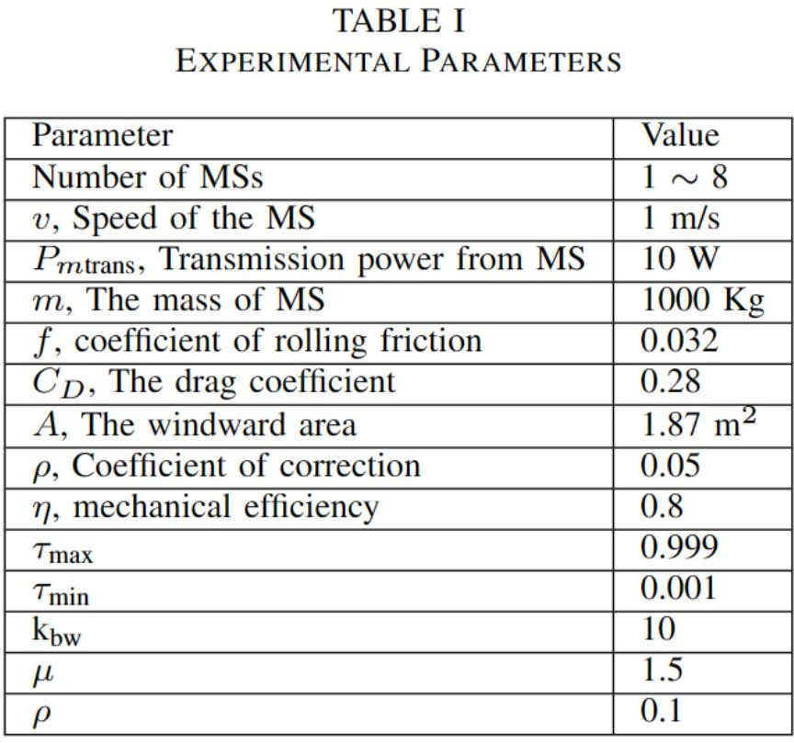
EXPERIMENTAL ANALYSIS:
Table shows the parameters used in the solution.

Slide 14
COMPARISON WITH BASELINES:
1. Greedy Approach:
Fig shows that our approach gives much lower energy consumption and much higher data coverage than the naive approach.
The naïve algorithm greedily gives the next best vertex based on the constraints.
2. MSPP Algorithm:
The MSPP algorithm uses a GAT network to model the system architecture. It then uses a twin PPO and Deep Q-Learning approach to search for the next best vertex based on a reward function.
While it gives a higher data collection rate, our paper provides better energy consumption while not compromising much on data collection.

Slide 15
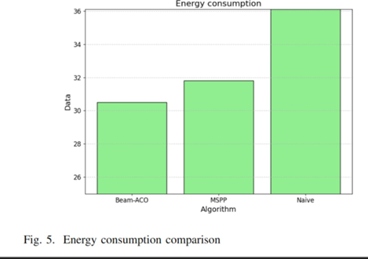
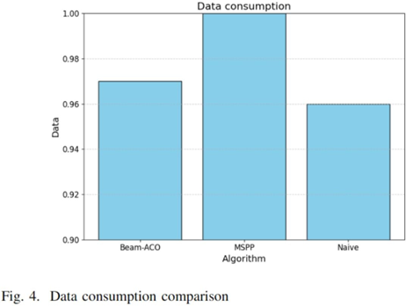
Data Consumption Comparison:

Slide 16
CONCLUSION:
Based on real-world datasets, this paper concludes that the application of the Ant Colony Optimisation algorithm coupled with Beam Search can solve the data collection problem in wireless heterogeneous sensor networks(HWSNs).
This problem has widespread applications in many real-world scenarios, including monitoring pollution levels and collecting wildlife data in remote places where only UAVs can navigate data collection.
Future works can further optimize data collection. The idea of multiple MSs optimally dividing the path to be visited can also be explored.

Slide 17
References
Z. Lin, H.-C. Keh, R. Wu, and D. S. Roy, “Joint data collection and fusion using mobile sink in heterogeneous wireless sensor networks,” IEEE Sensors J., vol. 21, no. 2, pp. 2364–2376, Jan. 2021.
Osamy, A. Salim, A. M. Khedr, and A. A. El-Sawy, “IDCT: Intelligent data collection technique for IoT-enabled heterogeneous wireless sensor networks in smart environments,” IEEE Sensors J., vol. 21, no. 18, pp. 21099–21112, Sep. 2021
N. Kumar, P. Rani, V. Kumar, S. V. Athawale, and D. Koundal, “THWSN: Enhanced energy-efficient clustering approach for three-tier heterogeneous wireless sensor networks,” IEEE Sensors J., vol. 22, no. 20, pp. 20053–20062, Oct. 2022.
T. Palanisamy, D. Alghazzawi, S. Bhatia, A. A. Malibari, P. Dadheech, and S. Sengan, “Improved energy based multi-sensor object detection in wireless sensor networks,” Intell. Autom. Soft Comput., vol. 33, no. 1, pp. 227–244, 2022.
Z. Sun, S. Zou, R. Zhang, and Q. Li, “Quickest change detection in anonymous heterogeneous sensor networks,” IEEE Trans. Signal Process., vol. 70, pp. 1041–1055, 2022
M. Yang, N. Liu, Y. Feng, H. Gong, X. Wang and M. Liu, ”Dynamic Mobile Sink Path Planning for Unsynchronized Data Collection in Heterogeneous Wireless Sensor Networks,” in IEEE Sensors Journal, vol. 23, no. 17, pp. 20310-20320, 1 Sept.1, 2023, doi:10.1109/JSEN.2023.3294232.

